Slide 1
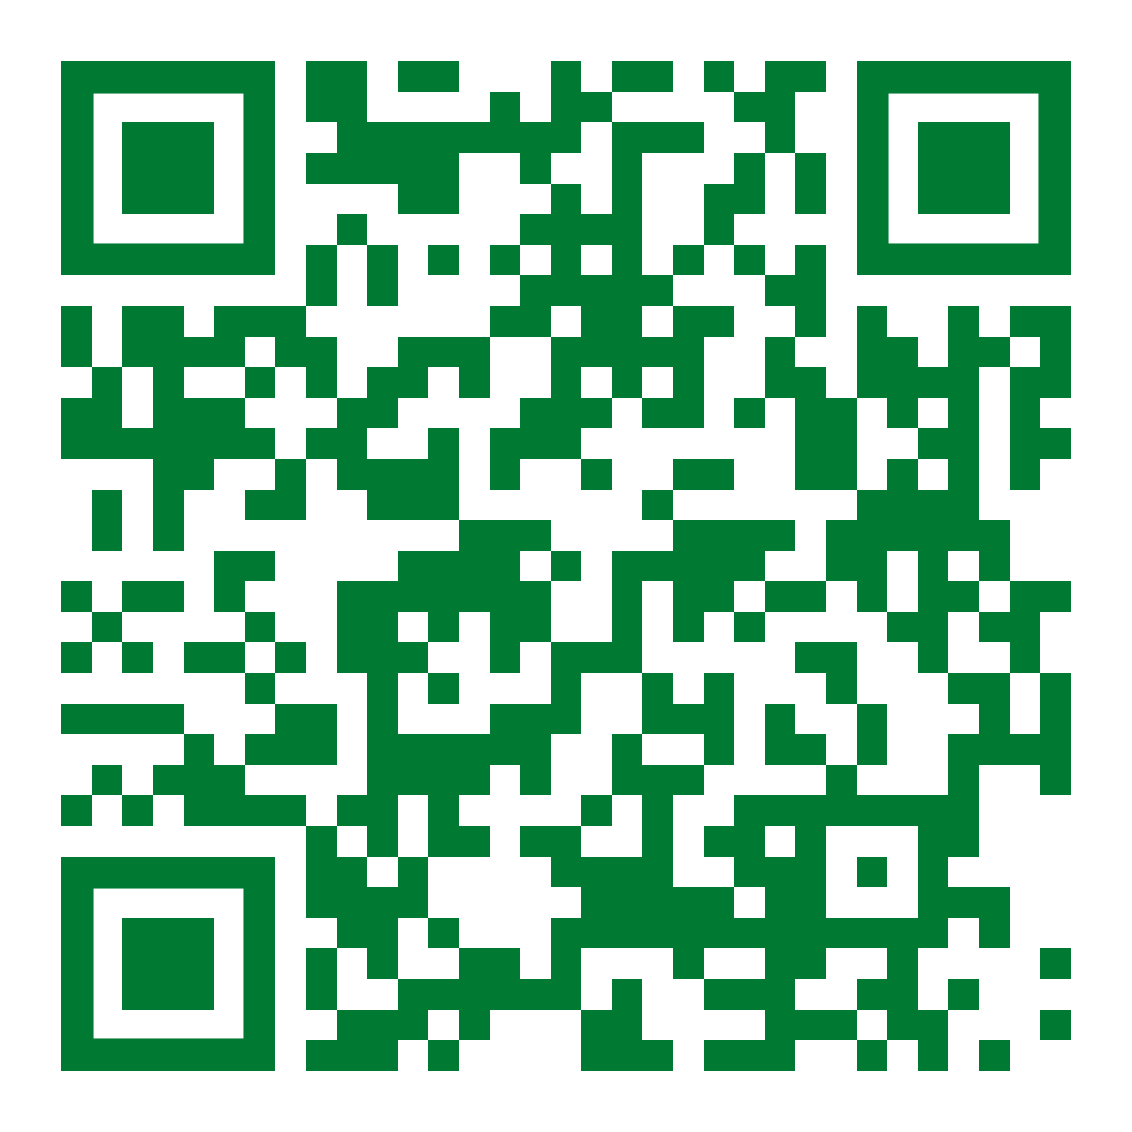
$6,000
GRAINGER POWER ENGINEERING STUDENT AWARDS
U. S. Citizenship and a minimum GPA of 3.0 are required
Must graduate in August 2023, December 2023, or May 2024
Application deadline: 01/31/2024
For more information visit:
http://power.mst.edu/awardsscholarships/index.html

